Slide 1
Import data using
parameters
Import data using
parameters

Slide 2
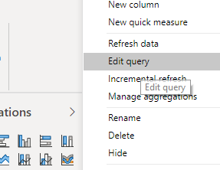
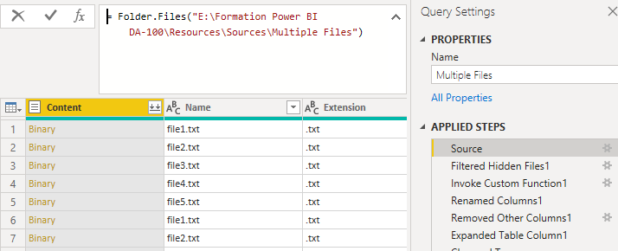
Importing data with parameters
Note: This Lab uses the csv files located at \resources\Source Files
Edit the imported query
Select source and then edit the Query M

Slide 3
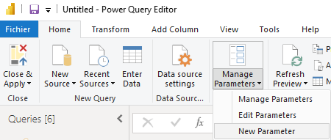
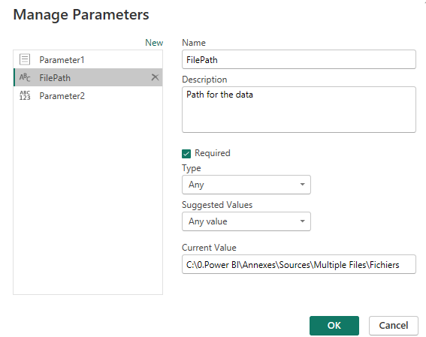
Importing from multiple files
Create a parameter named FilePath with Text as type, choose as Default Value the location of the replicated folder
1
2
4
3
5
Notice that the data remains intact without errors

Slide 4
Thank you
Thank you

